Slide 1
UNDERSTANDING NATURAL LANGUAGE QUESRIES OVER RELATIONAL DATABASES. SIGMOD RECORD, MARCH 2016
FEI LI UNIV. OF MICHIGHAN H.V. JAGADISH UNIVERSITY OF MICHIGAN
Buzaaba Happy, Aug 2018
Notes:
- Today I will present this paper called Understanding natural language queries over relational databases.

Slide 2
Problem description
Problem Description
Previous work
Proposal
Experiments
Conclusion
Notes:
And the presentation is organized in the following order.

Slide 3
Problem description
Understand natural language
Create queries
Run query on Relational database
Notes:
Querying data in relational databases is challenging for users without technical training.
The paper describes an architecture of an interactive natural language query interface for relational database.
In other words an interface that would allow users to query databases with natural language

Slide 4
Previous work
I. Androutsopoulos, G.D. Ritchie, and P. Thanisch. Natural Language Interface to databases – an introduction. Natural Language Engineering, 1(1):29-81, 1995
J. M. Zelle and R.J. Mooney. Learning to pass database queries using inductive logic Programming. AAAI 1996.
Y. Li, H. Yang, and H. V. Jagadish. Nalix: An interactive Natural Language Interface for querying xml. SIGMOD 2005.
Notes:
A number of studies have been conducted and some of them include:
Presents Overview of NLIDS, Advantages and Disadvantages, and the Linguistic problems that NLIDBS can confront.
Presents a system to automate the construction of a natural language interface for database queries. The system can learn semantic grammars from training examples.
Presents an interactive query interface where translation is done through mapping grammatical proximity of natural language parsed tokens to proximity of corresponding elements in the resulting XML.

Slide 5
Proposed Method
Main components:
Representation that is both human and RDBMs understandable (query tree)
Verifies transformation interactively with the user
Translate query tree to standard query language(SQL)
Notes:
Component1: responsible for interpreting the natural language query and representing the interpretation as a query tree (which is understandable by human and RDBMs)
Component2: This component is essentially responsible for communicating with the user to ensure the interpretation process is correct
Component3: In this component the query tree is translated to SQL and evaluated on RDBMs

Slide 6

Proposed Method
User Interface
Interpretations
Choice
Interactive Communicator
RDBMS
NLQ
Candidate
Mappings
Candidate
Query Trees
Choice
Choice
SQL
Dependency Parser
Parse Tree Node Mapper
Parse Tree Structure Adjuster
Query Tree Translator
Parse Tree
Parse Tree &
Mapping
Query Tree
Query Interpretation
Notes:
The first obstacle in translating Natural Language to SQL is to understand natural language query linguistically and this system uses Stanford parser to generate linguistic parse tree from the natural language query.
The parse tree is passed on to the query interpretation part for interpretation and representing it as a query tree.
In this part we also have the interactive communicator responsible for communicating with the user to ensure that the interpretation process is correct.
And finally the query tree possibly verified by the user will be translated into SQL in the query tree translator and evaluated against RDBMS

Slide 7
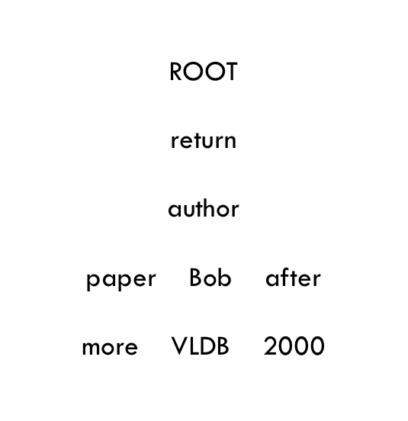
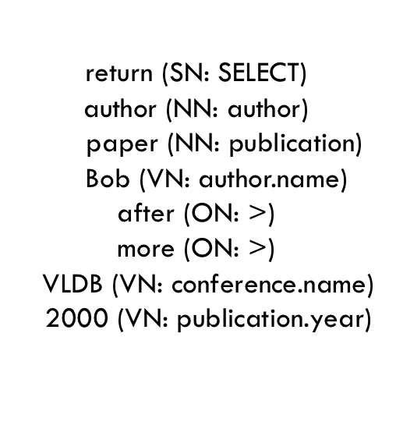
Proposed Method: Dependency Parser
Query example: Return authors who have more papers than Bob in VLDB after 2000.
Parse Tree
User Interface
Interactive Communicator
RDBMS
NLQ
Candidate
Mappings
Candidate
Query Trees
Choice
Choice
SQL
Dependency Parser
Parse Tree Node Mapper
Parse Tree Structure Adjuster
Query Tree Translator
Parse Tree
Parse Tree &
Mapping
Query Tree
Stanford Parser: Parsers work out the grammatical structure of sentences
Notes:
Parsers are used to work out the grammatical structure of sentences, in other words
Which group of words go together as phrases or which words are the subject or object of the verb.
In this this case the stanford parser is applied to generate the linguistic parse tree from NLQ
Here is the simplified linguistic parse tree where (each node is a word or phrase and each edge is a linguistic dependency relation between two words or phrases)

Slide 8
Parse Tree nodes and SQL component
Node Type | Corresponding SQL Component
Select Node (SN) | SQL keyword: SELECT
Operator Node (ON) | An operator, e.g. =, <=, |=, contains
Function Node (FN) | An aggregation function, eg., AVG
Name Node (NN) | a relation name or attribute name
Value Node (VN) | A value under an attribute
Quantifier Node (QN) | ALL, ANY, EACH
Logic Node (LN) | AND, OR, NOT

Slide 9
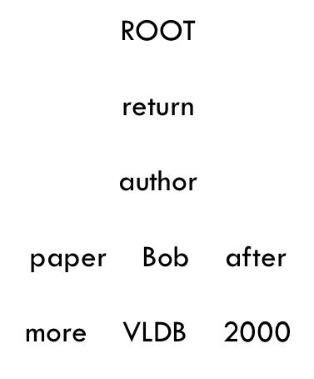
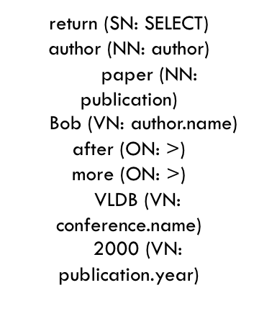
Proposed Method: Parse Tree Node Mapper
Query example: Return authors who have more papers than Bob in VLDB after 2000.
User Interface
Interactive Communicator
RDBMS
NLQ
Candidate
Mappings
Candidate
Query Trees
Choice
Choice
SQL
Dependency Parser
Parse Tree Node Mapper
Parse Tree Structure Adjuster
Query Tree Translator
Parse Tree
Parse Tree &
Mapping
Query Tree
Query Interpretation
Notes:
The parse tree node mapper identifies nodes that can be mapped on to SQL components and tokenizes them.
During the mapping some nodes may fail, for such nodes a warning is generated telling the user that these nodes do not contribute directly in query mapping.
There are also some nodes which may have multiple mappings that cause ambiguity in interpretation. for each such node, The best mappings are output to parse tree structure adjuster by default and all other candidate mappings are reported to the interactive communicator from which the user makes a choice.
For each ambiguous part multiple choice selection is generated from which the user makes the choice.

Slide 10
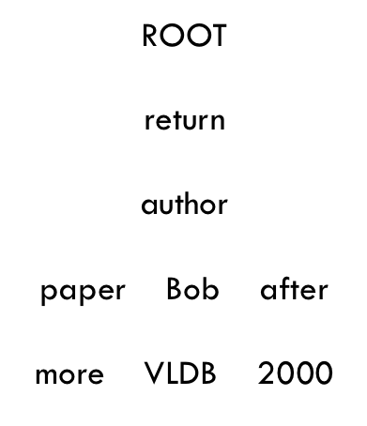
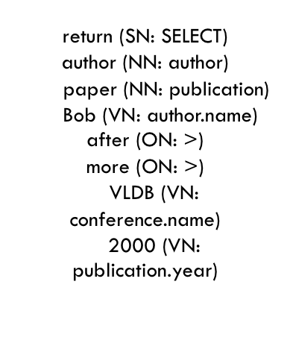
Proposed Method: Parse Tree Structure Adjuster
User Interface
Interactive Communicator
RDBMS
NLQ
Candidate
Mappings
Candidate
Query Trees
Choice
Choice
SQL
Dependency Parser
Parse Tree Node Mapper
Parse Tree Structure Adjuster
Query Tree Translator
Parse Tree
Parse Tree &
Mapping
Query Tree
Reformulate the nodes in parse tree to make it fall in the syntactic coverage of the system
Analyze the chosen parse tree semantically and insert implicit nodes to make it more
semantically reasonable
Notes:
After node mapping it is assumed that each node is understood by the system, and so the next step is to understand the tree structure from database perspective.
And this is done in two steps:
So given the linguistic parse tree, it is reformulated in multiple ways and the top k rough interpretations are generated.
It is mentioned that the algorithm is designed in such a way that the parse tree is edited until it is syntactically valid according to the grammar they defined.

Slide 11
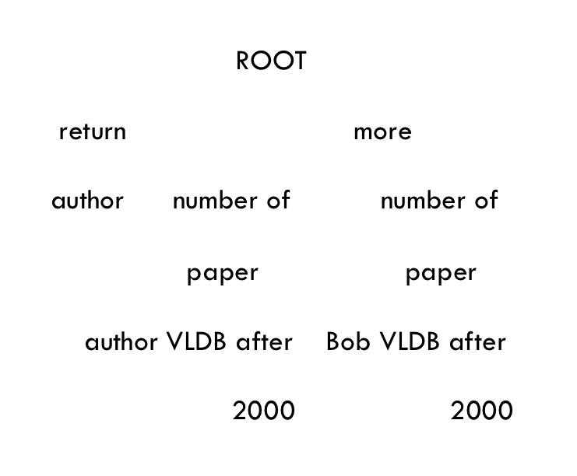
Proposed Method: Parse Tree Structure Adjuster
Query example: Return authors who have more papers than Bob in VLDB after 2000.
User Interface
Interactive Communicator
RDBMS
NLQ
Candidate
Mappings
Candidate
Query Trees
Choice
Choice
SQL
Dependency Parser
Parse Tree Node Mapper
Parse Tree Structure Adjuster
Query Tree Translator
Parse Tree
Parse Tree &
Mapping
Query Tree
Reformulate the nodes in parse tree to make it fall in the syntactic coverage of the system
Analyze the chosen parse tree semantically and insert implicit nodes to make it more
semantically reasonable
Notes:
After node mapping it is assumed that each node is understood by the system, and so the next step is to understand the tree structure from database perspective.
And this is done in two steps:
The insertion of implicit nodes is an inference of the semantic meaning for the query which can not guarantee accuracy. As such, the whole process is done under the supervision of the user.

Slide 12
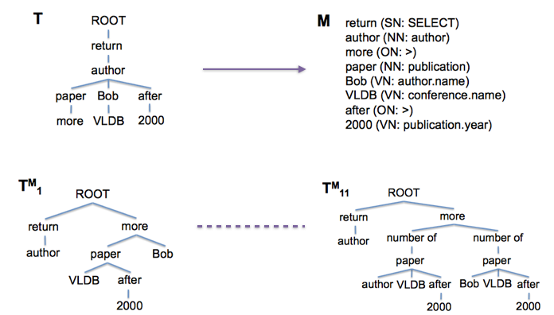
Proposed Method
Query example: Return authors who have more papers than Bob in VLDB after 2000.
return the authors, where papers of the author in VLDB after 2000 is more than Bob
Notes:
So here is the complete example:
Given this query, this parse tree is generated and in the first step the node mapper generates the best mapping as shown in M by default.
Now in the next step, the parse tree adjustor reformulates the structure of T and generates the top k valid parse trees in which Tm1 is the best.
The interactive communicator explains each of the k valid parse trees to the user in Natural language for the user to choose from.
For example: Tm1 is explained as,
And in the final part TM1 is fully instantiated in the parse tree structure adjustor by inserting implicit nodes an the resulting query is shown.

Slide 13
Experiment
Dataset: Microsoft Academic Search
Comparison results with MAS website
Relation | #tuples | Relation | #tuples
Publication | 2.45M | Author | 1.25M
cite | 20.3M | Domain | 24
Conference | 2.9k | Journal | 1.1k
Organization | 11k | Keywords | 37k
Summary Statistics for MAS Database
Notes:
The microsoft academic search dataset is used in the experiment and the results are compared with MAS website.

Slide 14
Experiment
Effectiveness (the quality of returned results)
“evaluated as the percentage of the queries that were perfectly answered.”
Usability (how easy is the system for non technical users)
“time taken by participants for correctly processed queries.”
“filling out a post experiment questionnaire”
Notes:
Since the motivation is to enable non-technical users to compose logically complex queries over relational databases and get perfect results,
The two aspects evaluated are:
Effectiveness and usability
And filling out a post experiment questionnaire.

Slide 15
Experiment
Effectiveness (the quality of returned results)
“evaluated as the percentage of the queries that were perfectly answered.”
Easy: Return all conferences in database area
Medium: Return the number of papers in each database conference
Hard: Return the author who has the most publications in database area
 | with Interaction | without Interaction | MAS
Easy: | 34/34 | 26/32 | 20/33
Medium: | 34/34 | 23/34 | 18/32
Hard: | 20/30 | 15/32 | 18/33
Tables shows effectiveness (with/without interactive communicator) with MAS website
Notes:
A set of 196 queries were used and their level of complexity was marked as Easy, Medium and Hard according to levels of nesting to their corresponding SQL.
So the central Innovation of this paper is the possibility of User interaction. So the experiment was carried out with and without the user Interaction and compared the results with the MAS
Effectiveness and usability
And filling out a post experiment questionnaire.

Slide 16
Experiment
Usability (how easy is the system for non technical users)
“time taken by participants for correctly processed queries.”
 | with Interaction | without Interaction | MAS
Easy: | 48 | 34 | 49
Medium: | 70 | 42 | 67
Hard: | 103 | 51 | 74
Table shows average time in seconds needed for successfully accomplished query

Slide 17
Conclusion
An interactive natural language query interface for Relational Database
Generates multiple interpretations to find best one
Actual user experience is gathered to test the model
Even naive users can find complex results easily

